Slide 1
Collaborative Platform Version 5.0
Team Members
Product Owner
Adrian Alfonso
Juan Caraballo
Jorge Travieso

Slide 2
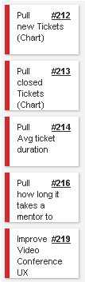


Sprint 3 Stories
My Sprint 3 Stories
Done and approved
Done and approved
Done and approved
Total 64 pts
Total 36 pts
Done and approved

Slide 3
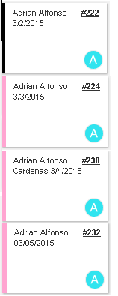
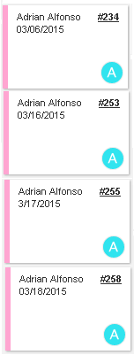
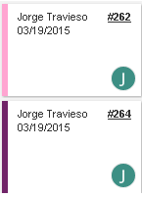
Daily Scrums

Slide 4
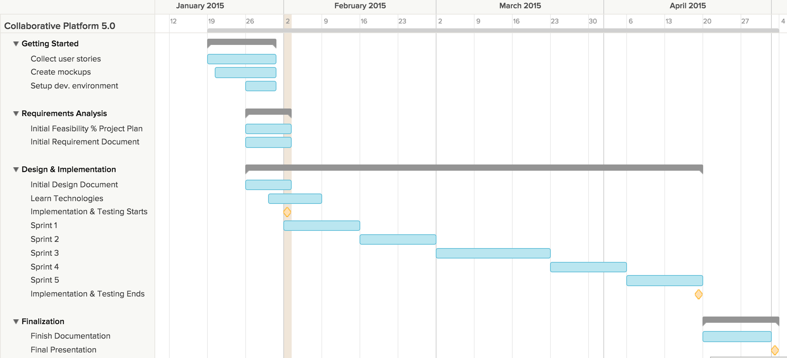
Project plan

Slide 5
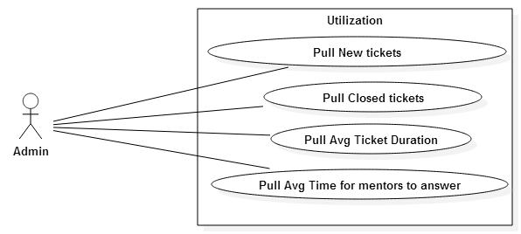
Use Cases

Slide 6
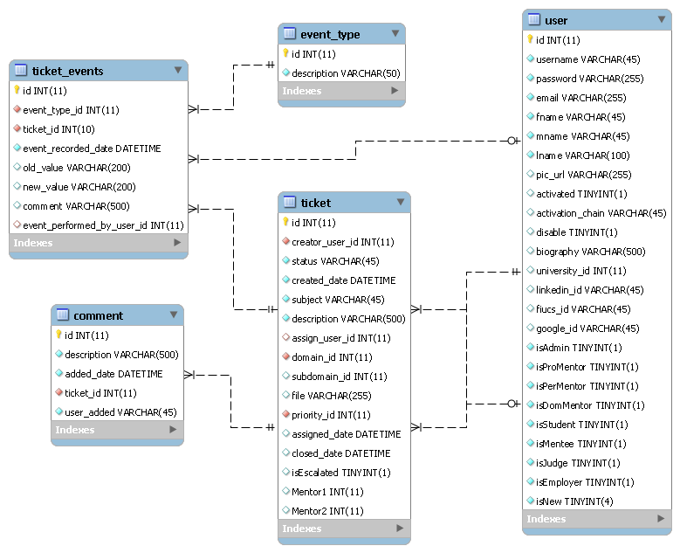
ER Diagram

Slide 7
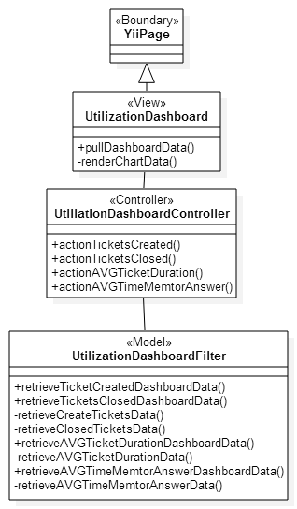
Class Diagram (Utilization Dashboard)

Slide 8
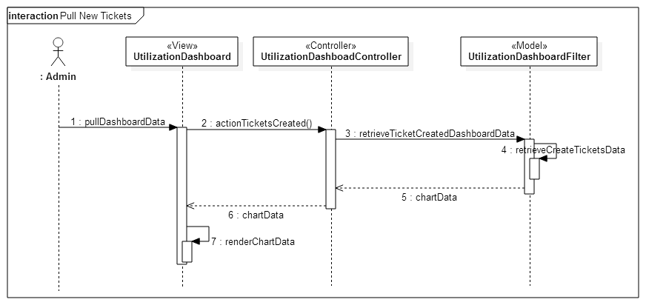
Sequence Diagram (Pull New tickets)

Slide 9
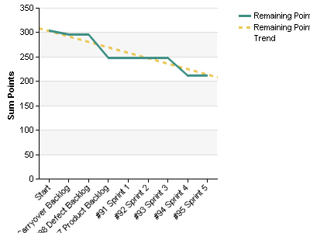
Burndown chart

Slide 10
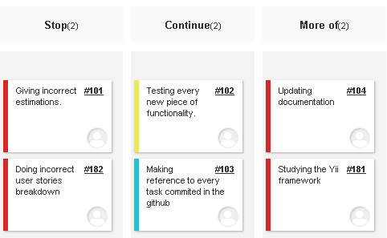
Retrospective

Slide 11
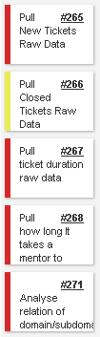
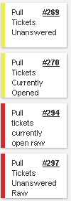
Sprint 4 Stories
Total 40pts

